Slide 1
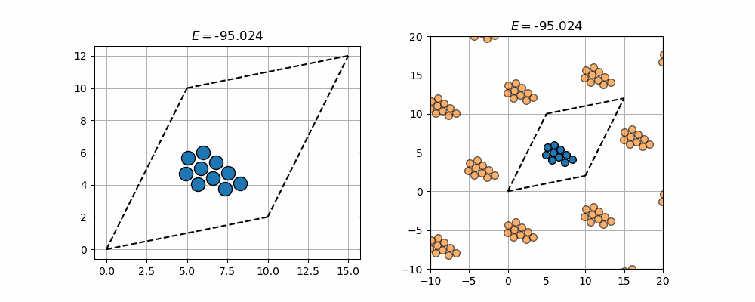
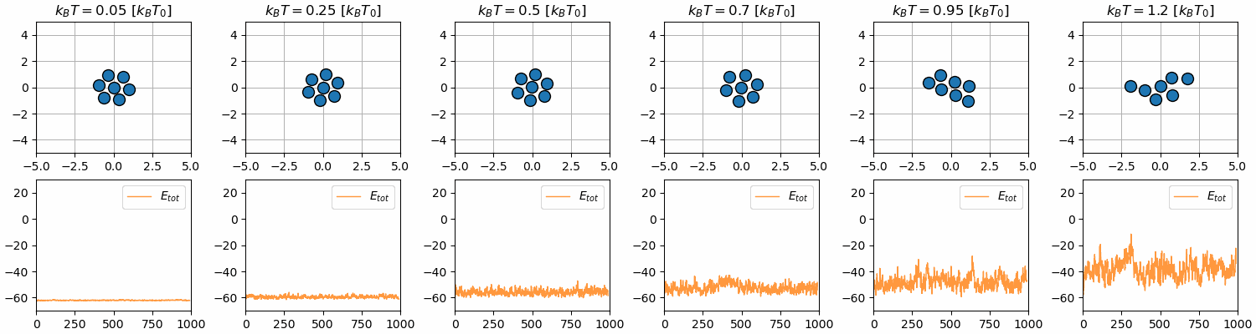
Simulation of phase transitions

Slide 2
Outline
Brief summary of what phase transitions are
Method for simulating these
Limitations of simulations
Results from exercise 27
Results from exercise 37 & 40

Slide 3
Phase transitions
Hysteresis

Slide 4
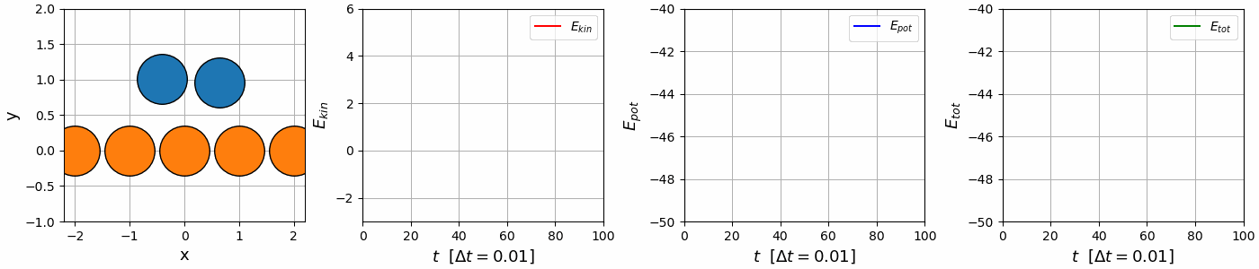
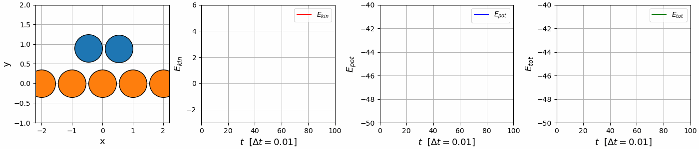
Methods for achieving phase transitions
MD-simulations → Integration of N2 + thermostat
Simulate atomic environments subject to thermostat
Achieve phase transitions & simulated annealing
Velocity
verlet
Euler integration

Slide 5
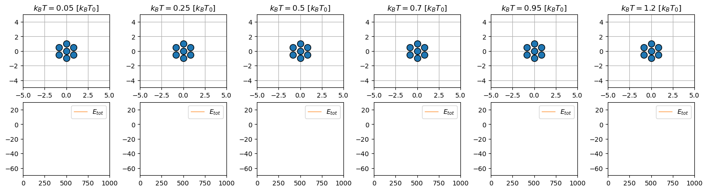
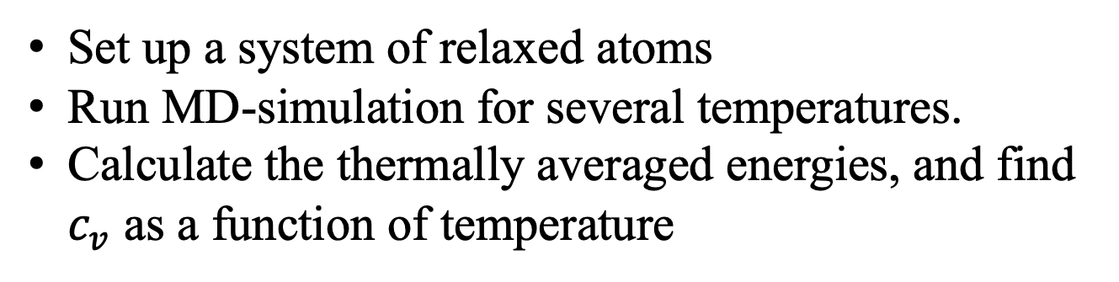
Exercise 27 – find phase transition
Set up a system of relaxed atoms
Run MD-simulation for several temperatures.
Calculate the thermally averaged energies, and find $c_{v}$ as a function of temperature

Slide 6
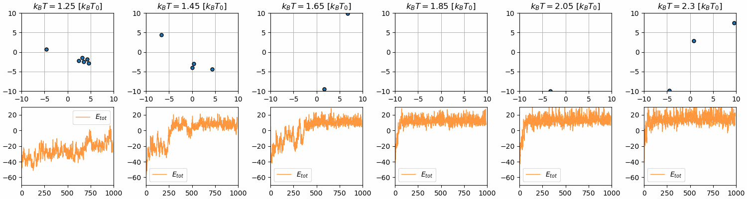
Exercise 27 – find phase transition

Slide 7
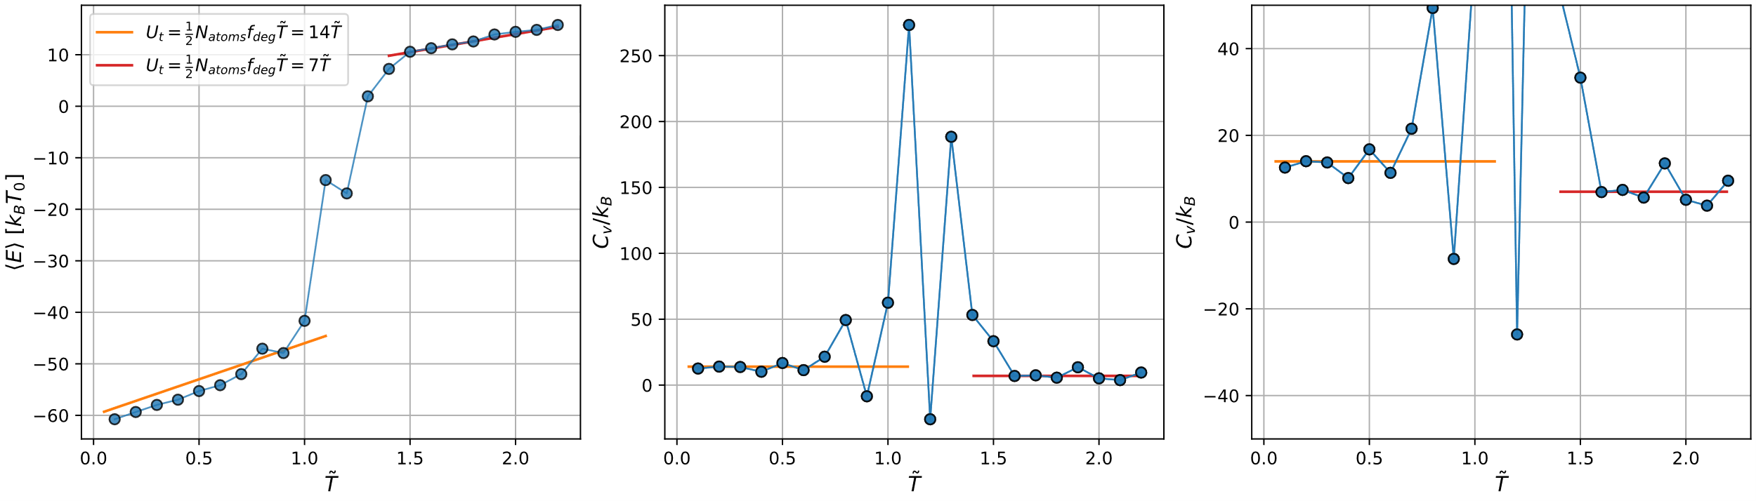
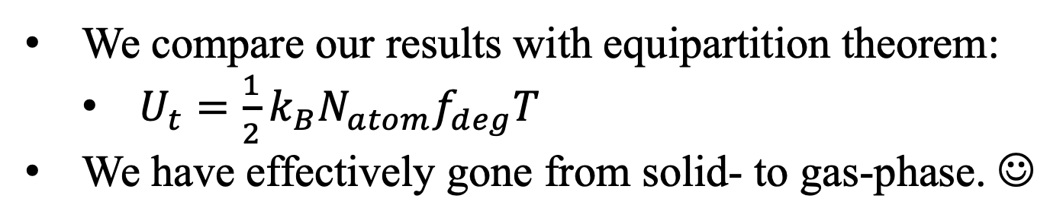
Exercise 27 – find phase transition
We compare our results with equipartition theorem:
$U_{t}=\frac{1}{2}k_{B}N_{atom}f_{deg}T$
We have effectively gone from solid- to gas-phase. ☺

Slide 8
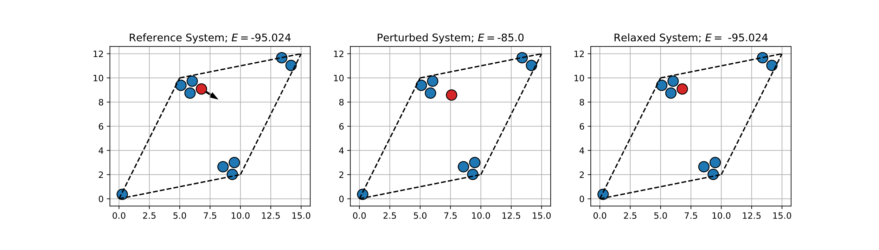
Methods for achieving phase transitions
What about pressure and volume?
No problem → finite simulation box + periodic boundary conditions (pbc)
Minimum image convention
Calculate pressure → scale volume + atom positions by pressure = barostat.

Slide 9
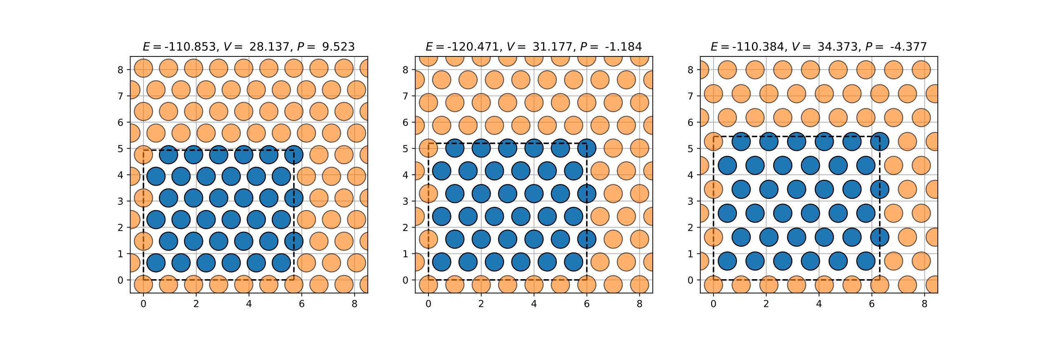
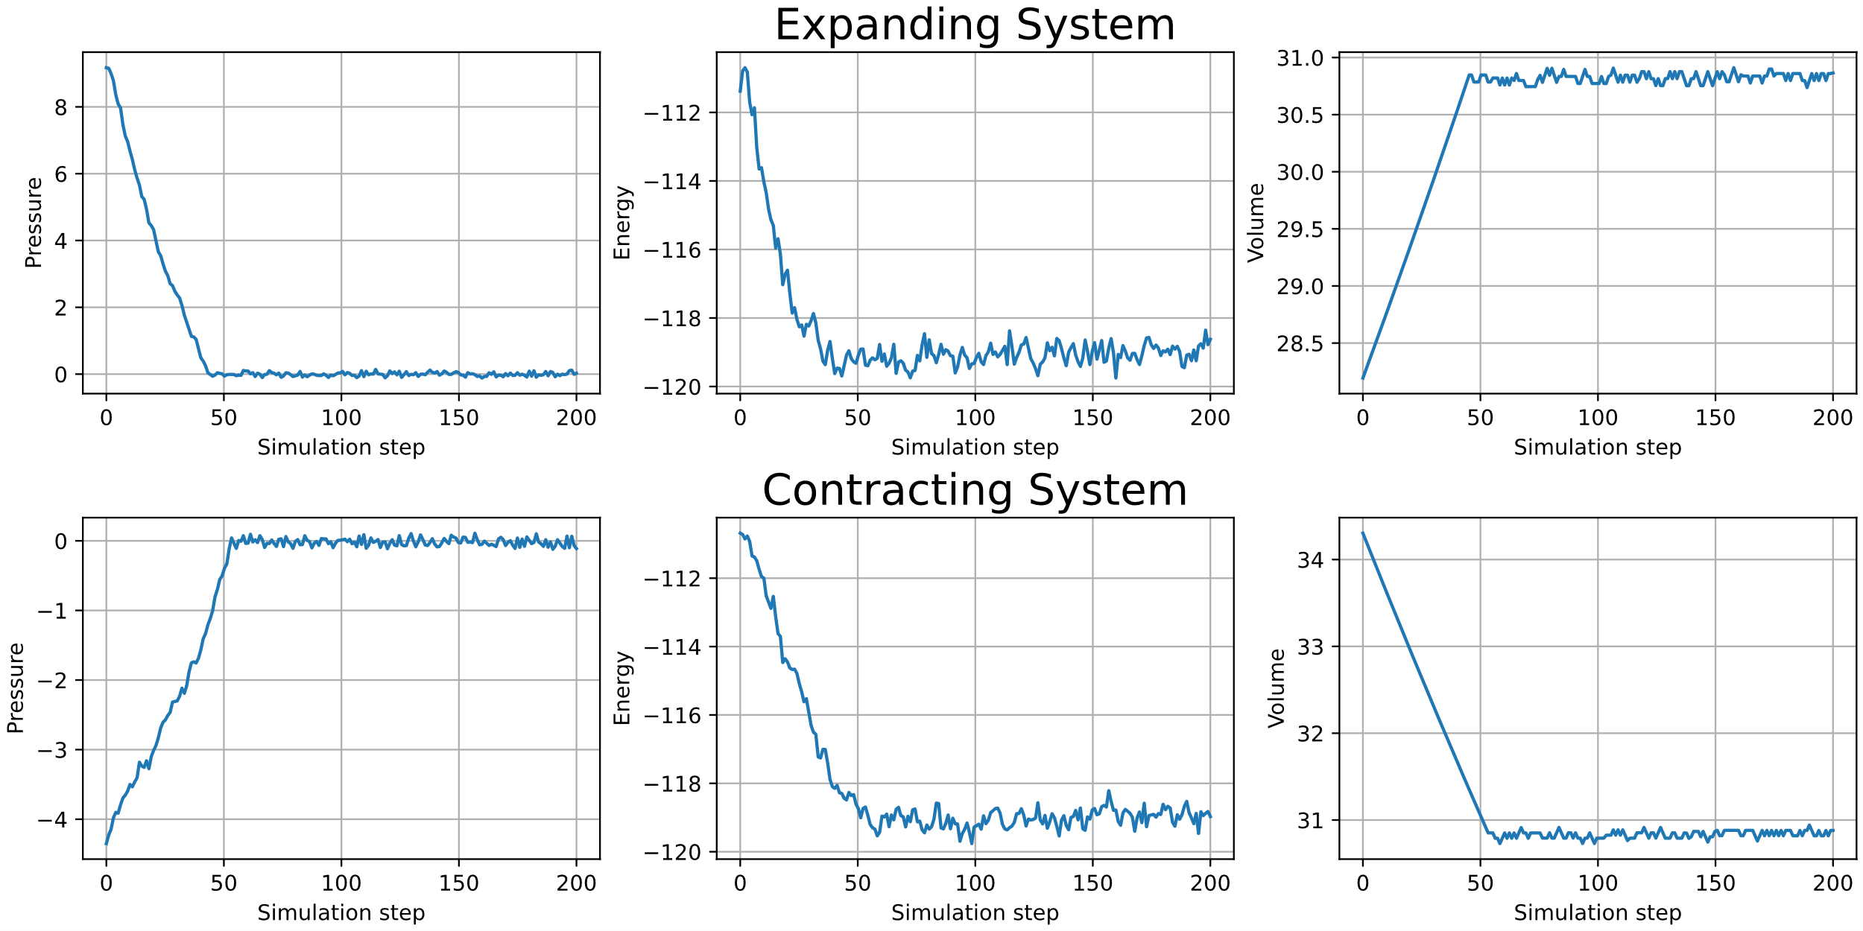
Exercise 37 & 40 – Implement & use

Slide 10
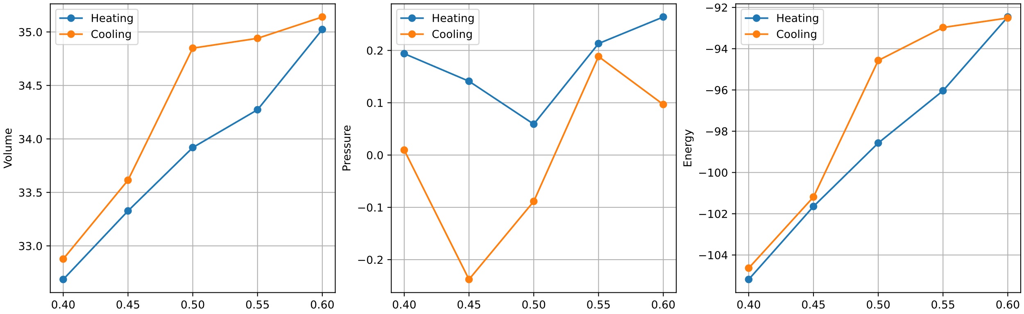
Exercise 37 – Implement & use
We heat up a system and subsequently let the pressure and volume equilibrate with 0 pressure.
Calculate average volumes, pressures and energies
Hysteresis
Behavior ☺

Slide 11
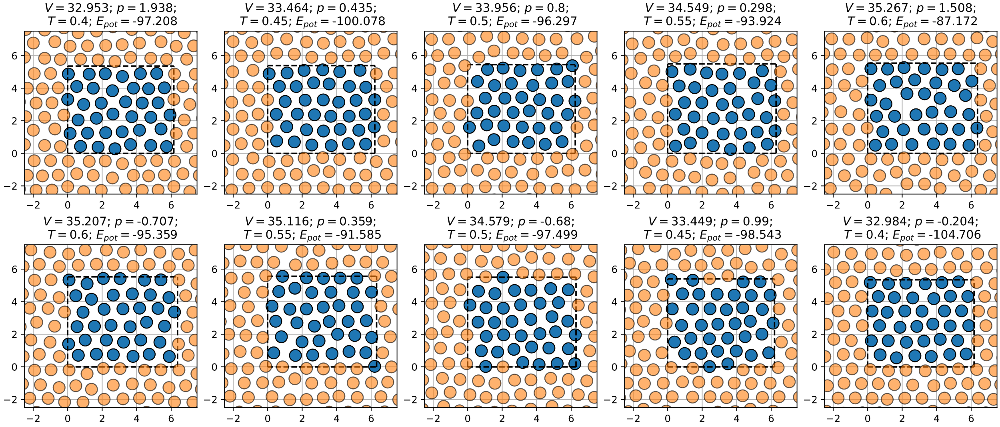
Exercise 37 – Implement & use

Slide 12
INSERT RESULTS FROM EXERCISE 40 HERE

